Slide 1
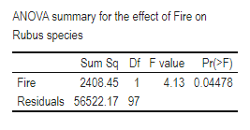
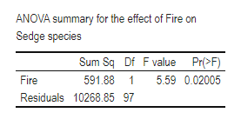
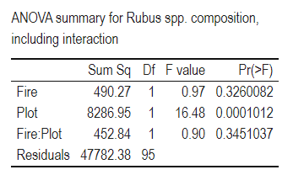
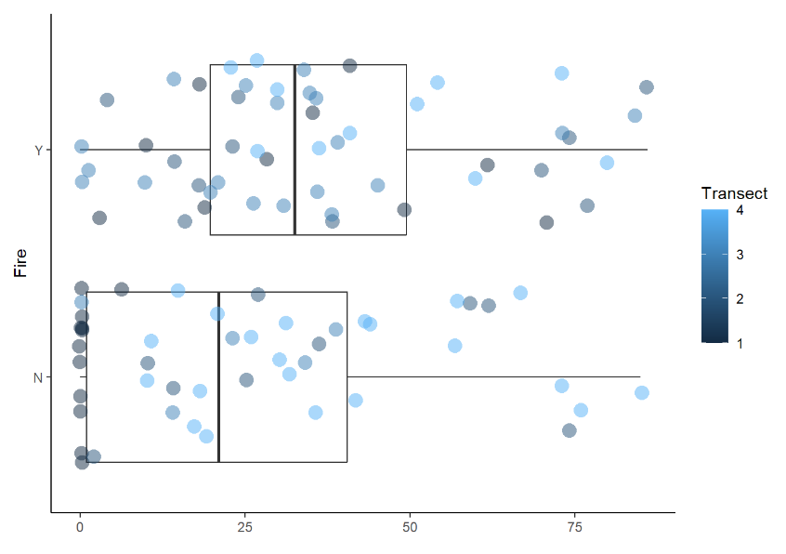
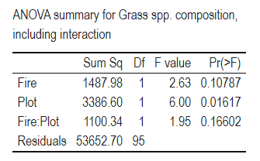
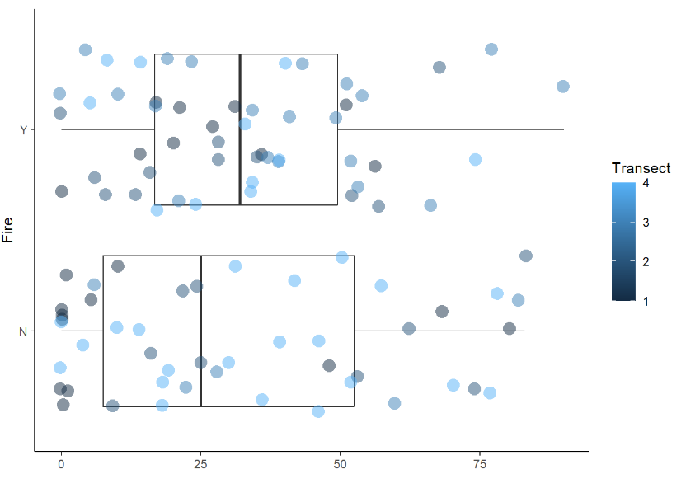
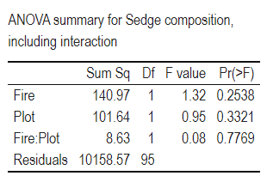
Vegetation Dynamics on Round Bald
J Ted Hillert
Western Carolina University Masters Student
Round Bald
Round bald is located along the borders of North Carolina and Tennessee along the Appalachian Trail. The site is about 20 miles North of Bakersville, North Carolina and about 13 miles South of Roan Mountain, Tennessee. Round bald has been experiencing woody encroachment from invasive species like Rubus allegheniensis, Rubus canadensis, Vaccinium spp., Rhododendrom spp. and saplings from the surrounding spruce-fir forest. These species are causing the bald to shift from a grass bald subtype into a heath bald subtype. Grass balds are defined when most of the vegetation is grass or sedge, while heath balds are dominated by ericaceous shrubs. Following woody encroachment, shrubs intermingle with grasses and sedge to transform the bald into the heath bald subtype. This conversion has the potential to extirpate a rare ecosystem that hosts several rare endemic species such as Roan Lily (Lilium grayi), Spreading Avens (Geum radiatum), and Roan sedge (Carex roanensis). In the nearly 40 years since the initial reports from Murdock (1986) and Hamel and Somers (1990), and the recent study by Stokes and Horton (2022), Round bald has been facing stand type alteration from a grass bald to a heath bald. In February of 2022, a ground fire broke out burning almost 10 hectares, or the first four transects re-established by Stokes and Horton (2022) who had surveyed the bald in 2020 examining vegetation dynamics following 30 years of management.
Methods
Preliminary Results
Future Work Summer of 2023
Study Site
Round bald is in the Roan Mountain Massif of the Unaka Mountain range of the Southern Appalachian Mountains, between Carver’s gap and Engine gap. The Appalachian Trail (AT) bisects the study site into North of the trail and South of the trail. The site itself is spread across Pisgah National Forest in North Carolina and Cherokee National Forest in Tennessee, at approximately 36° 06’N and 82° 60’W. In 2020, Stokes and Horton (2022) surveyed the balds of Carver’s Gap following a 30-year mowing management protocol from Hamel and Somers (1990) and Murdock (1986). They detailed the vegetation composition of the balds according to vegetation genera. Their data was entered into PCORD and produced a schematic of the vegetation communities across the balds of Carver’s Gap (McCune and Medfford 2016). In February 2022, a low-intensity ground fire burned roughly 9.7 hectares of aboveground vegetation and was quickly expunged before it could spread further. This provided an opportunity to examine the changes in vegetation composition following low-intensity ground fire over two sampling seasons in June of 2022 and 2023.
Field Methods
In this study I sampled the first four transects reestablished by Stokes and Horton (2022), quantifying vegetation to genera and combining genera into functional types; Rubus, Vaccinium, Rhododendron (Rhodo), Angelica, Forb, Fern, Grass, Sedge, Moss, Rock, or Bare ground. I measured the percent coverage of vegetation using a 1-m^2 PVC quadrat divided into 100 equal sized squares, following Stokes and Horton (2022). Each square was visually assigned by dominant vegetation genera to equal 100% coverage per plot of aboveground vegetation up to 1-meter in height. Using the data collection sheet from Stokes and Horton (2022) and USFS botanist Gary Kauffman - which quantifies vegetation based on focal genera - a total of 226 plots along 12 transects were sampled in 2020, of these, 52 plots - along the first four transects were in the February 2022 fire - and another 47 plots - along the same transects - were untouched by the fire.
Soil Seed bank
To examine the effects of the fire on the seed bank, seed bank samples were collected in July 2022 and January 2023. At those times, approximately 200 grams of soil was obtained from the top 5 cm of soil at six random sites in 2022 in one of four treatments; over 50% Rubus/burned, over 50% Rubus/unburned, under 25% Rubus/burned, under 25% Rubus/unburned. The first - over 50% Rubus/burned - describes plots with greater than 50% cover of blackberry and burned from the February 2020 fire, followed by greater than 50% blackberry and unburned, less than 25% blackberry and burned, lastly, less than 25% blackberry and unburned. Two measurements of the seed bank were collected in July of 2022 and January of 2023. In July 2022, I took 24 samples of the seed bank following the February 2022 ground fire that occurred on Round Bald. In January 2023, the second soil seed bank sample was collected at three spots, on three separate sites, along all four transects, in both burned and unburned areas of Round Bald. A total of 72 seed bank samples were collected and set in the fridge until March 2023. At that point, I plan to fractionate the samples into four categories; burned, unburned, control, and greenhouse control. I will then examine which vegetation genera germinate among each category. Initially these samples will be propagated with seltzer water to increase germination by providing extra CO2 to the seeds, followed by tap water to continue growth. This is because of a STEM student science project which showed carbonated water helping to jump start germination and tap water to supply micronutrients to the growing plants.
Greenhouse
A total of 24 soil seed banks samples were taken, placed in tins, transferred to the greenhouse, then sown in 28x22 cm seedling trays filled with potting mix to 5 cm depth. An additional six trays were filled with unaltered potting mix which acted as greenhouse controls to rule out contamination. Trays were then randomly set in the greenhouse at ambient temperature and humidity and measured continuously with a Govee probe - which continuously measures temperature, percent relative humidity (%RH), dew point (DP), and vapor-pressure-deficit (VPD). As seedlings emerged, they were identified, recorded, and removed. The seedlings that could not be identified were re-potted until identifiable following Price et al. (2010). Each month the trays were rotated in random order to rule outgrowth condition bias. In December of 2022, the soil sample trays were placed outside to simulate winter conditions and potentially germinate seeds in the seed bank over the next spring. A second soil seed bank germination trial following the same protocol will be conducted in mid-to-late March of 2023 onward. These samples will examine what is readily germinable following natural winter weathering and will be compared to the first seed bank set to examine post burn germinable seeds versus post winter germinable seeds.
Data are still being reviewed, however initial analyses shows a significant effect on Rubus spp. (p=0.04478) (Table 1) and on Sedge species (p=0.02005) (Table 2). With an insignificant effect on grass species. In these instances, the focal vegetation type (Rubus, Sedge, Grass) were modeled against Fire (occurrence; Y or N).
A second analysis of focal vegetation was run against fire with plot as an interaction which showed significant across focal types. More analysis is undergoing to examine effect size.
Field Methods
In the summer of 2023, I plan to repeat surveys of the first four transects. In 2022, soil emergence was utilized for the sake of time, and I plan to add a modified soil extraction method from Price et al. (2010); Abella et al. (2013); and Chiquoine and Abella (2018) for the second sample set. These authors identify that both methods can provide insight into the potential vegetation community, but a combination of the two provides a more robust estimate of the state of the seed bank. In the second method to the soil seed bank analysis, I will fractionate the samples into field control, greenhouse control (unaltered potting mix), burned, and unburned. These samples will be exposed to two levels of light, humidity, soil moisture, and temperature to examine the germination requirements of seeds in the seed bank. This should make it more comparable to the current vegetation structure and speculate on the future composition of Round Bald as a result of continued mowing management.
Objectives, Question, and Hypothesis
References
The objectives of this study are;
Quantify vegetation composition and the soil seed bank over the first and second growing seasons following the low intensity ground fire on Round Bald, and
Propose methods to improve management for conservation of these rare ecosystem subtypes.
The general question is, how has the low-intensity ground fire affected vegetation dynamics and are there management practices that could be gleaned from this disturbance?
I expect that there is little to no decrease in the cover of Rubus spp., likely there will be a slight increase in blackberry cover following slight scarification from the February 2022 ground fire.
Figure 1. The effect of Fire on Rubus species with Plot as an interaction. Data are delimited as burned (Y) or unburned (N) and colored according to transect (1-4).
Figure 2. The effect of Fire on Grass species with Plot as an interaction. Data are delimited as burned (Y) or unburned (N) and colored according to transect (1-4).
Abella, S. R., L. P. Chiquoine, and C. H. Vanier. 2013. Characterizing soil seed banks and relationships to plant communities. Plant Ecology 214:703–715.
Chiquoine, L. P., and S. R. Abella. 2018. Soil seed bank assay methods influence interpretation of non-native plant management. Applied Vegetation Science 21:626–635.
Davies, R. 1998. Regeneration of blackberry-infested native vegetation. Plant Protection Quarterly 13:189–195.
Gersmehl, P. 1970. A geographic approach to a vegetation problem: The case of the southern appalachian grass balds. Ph.D. Dissertation, University of Georgia, Athens, GA. 463 pp.
Hamel, P., and P. Somers. 1990. Vegetation analysis report: Roan mountain grassy balds. Challenge Cost Share Project.:25.
Lindsay, M. M., and S. P. Bratton. 1979a. The vegetation of grassy balds and other high elevation disturbed areas in the great smoky mountains national park. Bulletin of the Torrey Botanical Club 106:264–275.
Lindsay, M. M., and S. P. Bratton. 1979b. Grassy balds of the great smoky mountains: Their history and flora in relation to potential management. Environmental Management 3:417–430.
Lindsay, M. M., and S. P. Bratton. 1980. The rate of woody plant invasion on two grassy balds. Castanea 45:75–87.
McCune, B., and M. J. Medfford. 2016. PC-ORD. Multivartiate analysis of ecological data. Version 7. MjM Software Design, Gleneden Beach, Oregon, USA.
Monar, K. C., and N. D. at W. C. University. 2018. The role of the soil seed bank in southern appalachian wildfire response.
Moravek, S., J. Luly, J. Grindrod, and R. Fairfax. 2013. The origin of grassy balds in the bunya mountains, southeastern queensland, australia. The Holocene 23:305–315.
Murdock, N. A. 1986. Evaluation of management techniques on a southern appalachian bald. Unpublished M.S. Thesis. Western Carolina University. 62 pp.
Price, J. N., B. R. Wright, C. L. Gross, and W. R. D. B. Whalley. 2010. Comparison of seedling emergence and seed extraction techniques for estimating the composition of soil seed banks. Methods in Ecology and Evolution 1:151–157.
Stokes, C., and J. L. Horton. 2022. Effects of grassy bald management on plant community composition within the roan mountain massif. Castanea 87:105–120.
Weigl, P. D., and T. W. Knowles. 1995. Megaherbivores and southern appalachian grass balds. Growth and Change 26:365–382.
Weigl, P. D., and T. W. Knowles. 2014. Temperate mountain grasslands: A climate-herbivore hypothesis for origins and persistence. Biological Reviews 89:466–476.
Contact & Acknowledgements
J Ted Hillert
jrhillert1@catamount.wcu.edu
Acknowledgements: The instructors and professors that leant an eye to edit. The other graduate students that lent a hand.

